Slide 1
Your Future

Slide 2
Did you answer yes to any of these questions?
Do you like helping others?
Do you like working with young children?
Are you interested in Nutrition?
Do you stay up to date on the latest trends in Fashion?
Do you watch HGTV or design shows?
Are you interested in Culinary Arts?
Is your favorite class a Family and Consumer Sciences class?
Do you like FCCLA?

Slide 3
All of the questions have one thing in common….
They describe the job of a Family and Consumer Sciences teacher.

Slide 4
What is Family and Consumer Sciences
As a Family and Consumer Sciences teacher you can make a lifelong impact on young people through education that provides students the opportunity to explore and prepare for careers in culinary, nutrition, dietetics, education, early childhood, fashion design, interior design, textiles, tourism and hospitality, food science, social services and many human services related careers.

Slide 5
If I choose FACS, can I get a job?
Family and Consumer Sciences is experiencing a shortage of candidates for the jobs available
Placement is at 100% in Indiana for candidates.
According to the article, “10 Best Degrees For Finding A Job,” by Andrea Argueta
Family and Consumer Sciences degrees rank in the top 10 best degrees for finding a job.

Slide 6
Where can I go to school?
Ball State University
pstigall@bsu.edu
Indiana State University
Purdue University
Indiana FCCLA offers a scholarship for a student pursuing a degree in FCS.

Slide 7
Who can I contact?
Alyson L. McIntyre-Reiger State Program Leader- Family and Consumer Sciences
amreiger@doe.in.gov

Slide 8
Family and Consumer Sciences Education
Contact
Jennifer Rosselot Wilkins
undergraduate academic advisor
e-mail: jrosselo@purdue.edu (765) 494-8533
http://www.purdue.edu/hhs/hdfs/undergraduate/majors/FCSE.php
For all teacher-education majors,
http://www.teach.purdue.edu/becomeateacher/

Slide 9
Vincennes University
Family & Consumer Sciences Education A.S. Degree offered
Students complete the 2 year A.S. degree at VU and then must transfer to a 4 year school to complete the B.S. degree

Slide 10
Choose Facs Education @ Ball State

Slide 12
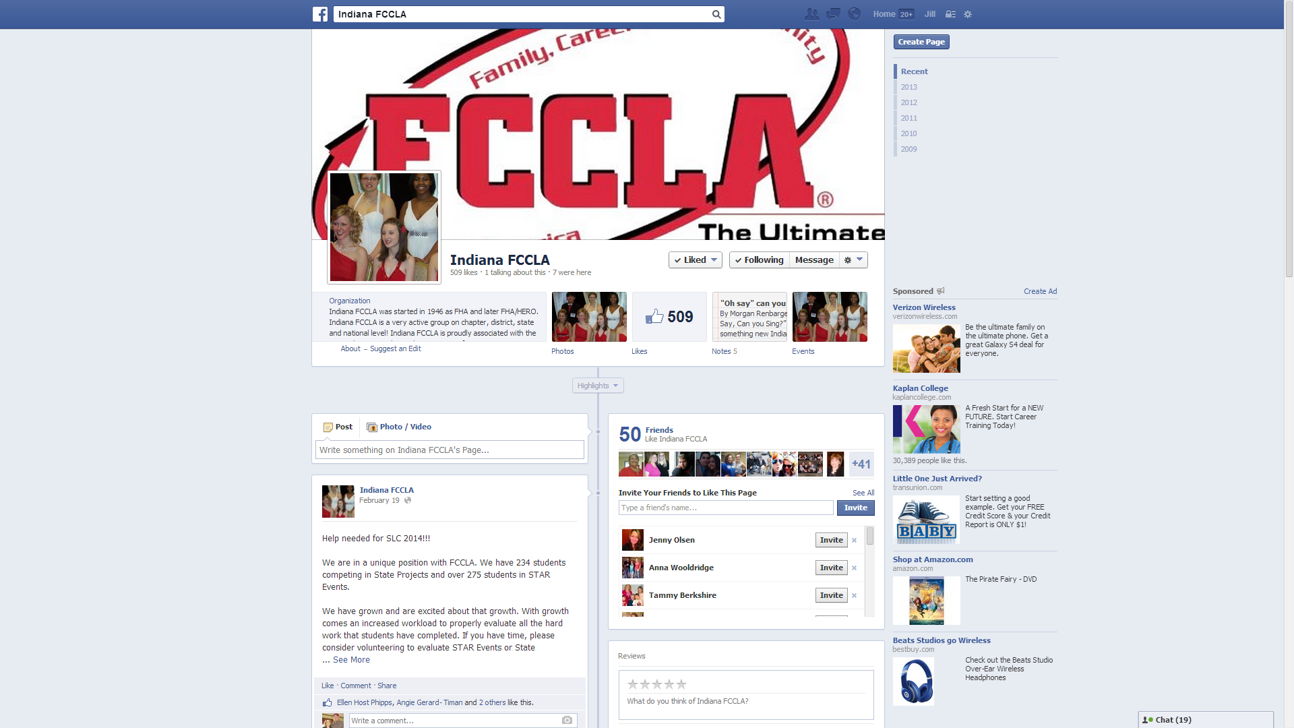
Join Indiana fACS on facebook

Slide 13
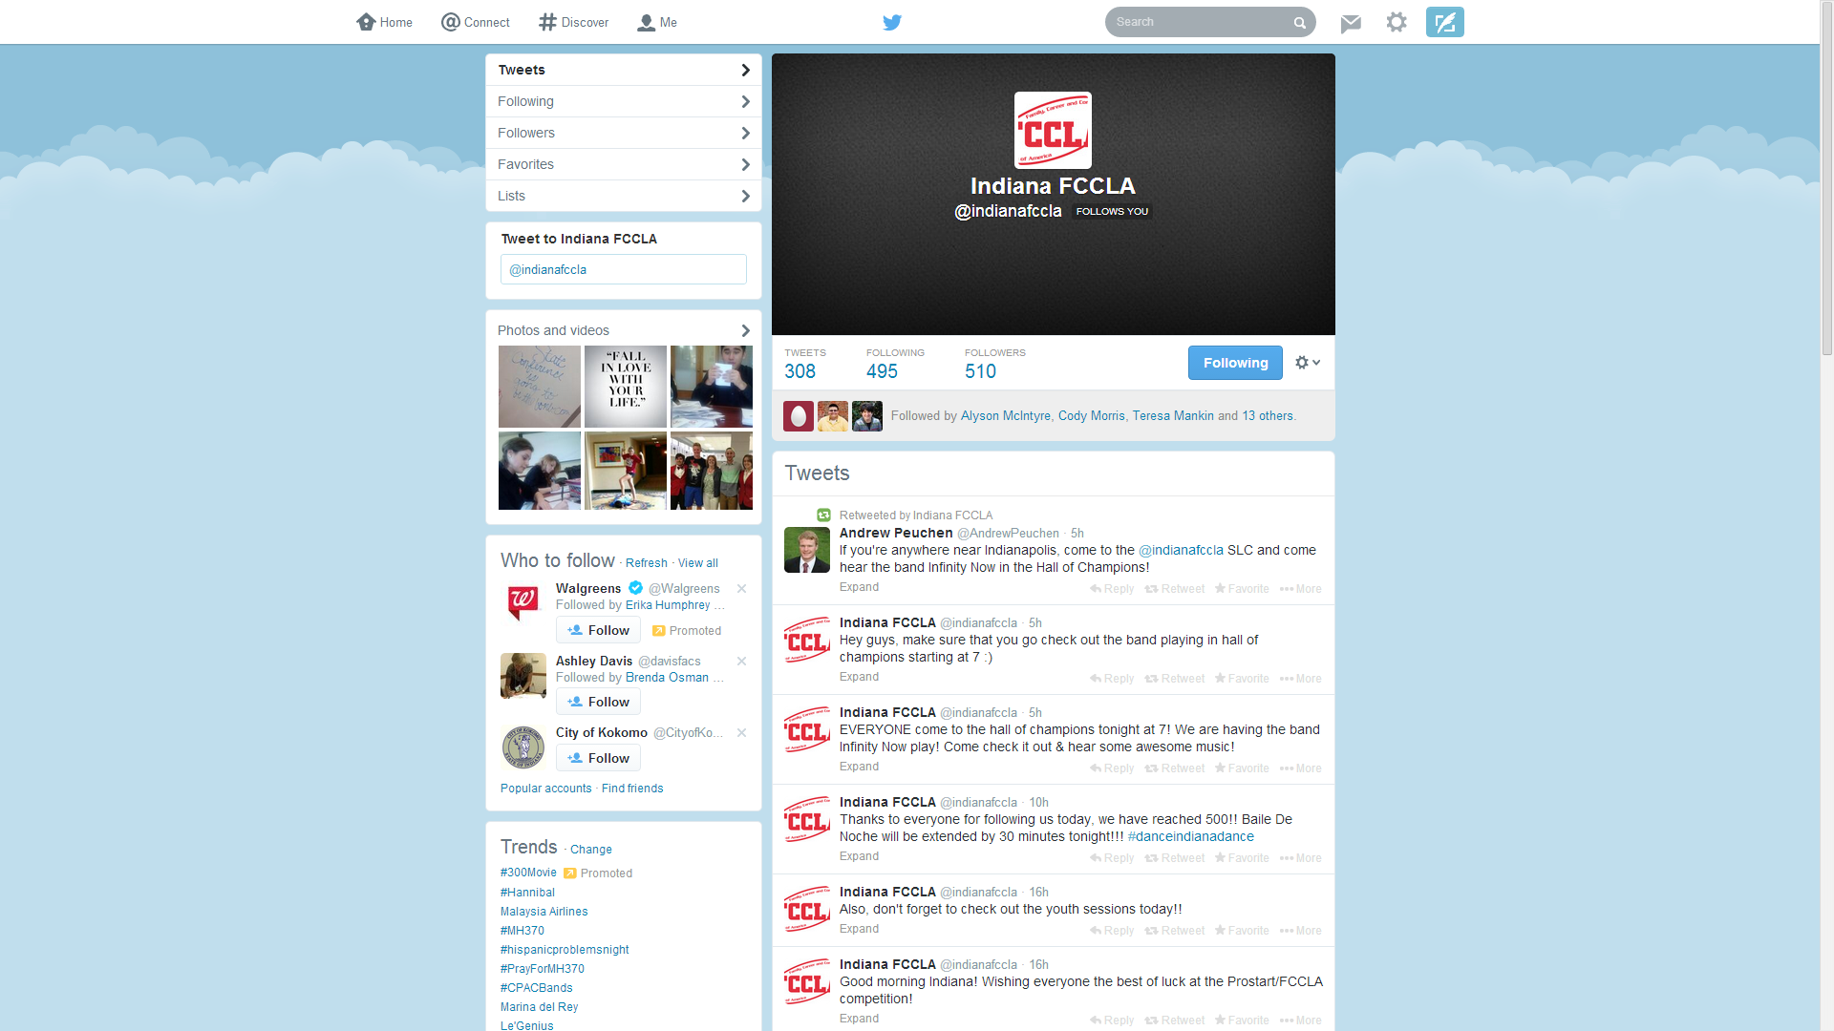
Tweet @ Indianafacs

